Slide 1
GlowUp
By : Keile Cruz-Maldonado, Maisha Fyruz

Slide 2

What is GlowUp?
GlowUp is a web based beauty marketplace that is designed to connect customers with reliable independent beauty professionals.
The website provides a platform for user’s to discover professional’s, view verified portfolios, book appointments, and manage their accounts. Additionally it allows professionals to create profiles, showcase their work, set services and prices, and manage appointments.

Slide 3
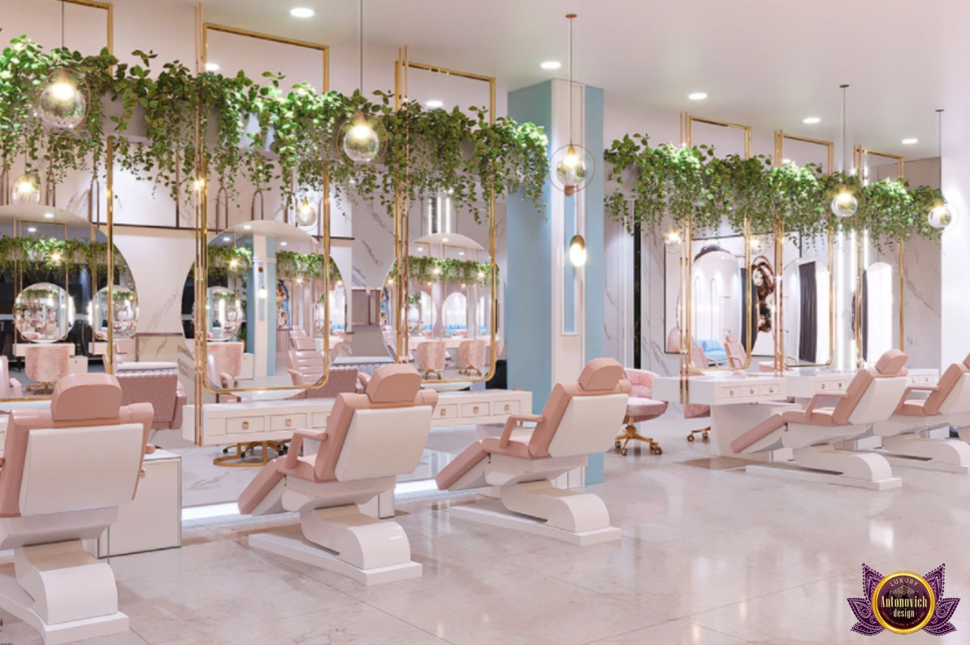
Purpose and Value
Problem :
Customer’s often struggle to find reliable beauty professionals due to misinformation, inconsistent booking, and limited access to verified portfolios and reviews. This in terms makes the process of discovering and scheduling services confusing and inefficient.
Solution :
GlowUp provides a more organized and trustworthy web-based platform that allow for the client and professional to connect and communicate efficiently.

Slide 4

Customer Prototype
When deciding for the design of the Customer prototype, the main focus was to have a clean user-centered interface that is easily accessible and manageable
The system would include a secure account access, structured search functionality, a browsing feature when discovering professionals, and an appointment booking system.
Portfolio viewing, account management, appointment tracking, and review submission would be included to allow customers to manage their interactions with professionals.

Slide 5

Provider Prototype
– The provider prototype gives beauty professionals a clear and easy interface to manage services and appointments.
– Providers can securely sign up, log in, and view a dashboard with bookings, ratings, earnings, daily schedule, and customer reviews.
– The system also supports portfolio management, service listing, gallery display, and booking control for efficient customer interaction.

Slide 6
Thank you!
Questions or Feedback?

